Slide 1


LISI Corporate Strategy
Shaho Vatandoust

Slide 2
Contents
Macro
Micro
Introduction
Scope
SWOT
Opportunities and Risks
Expectations
Solution
GANTT Chart
Conclusion

Slide 3
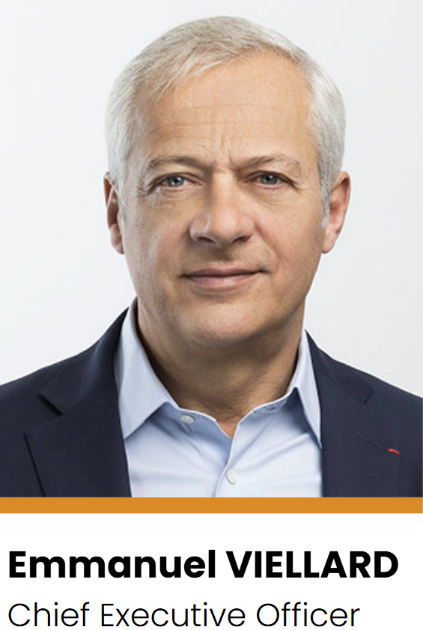
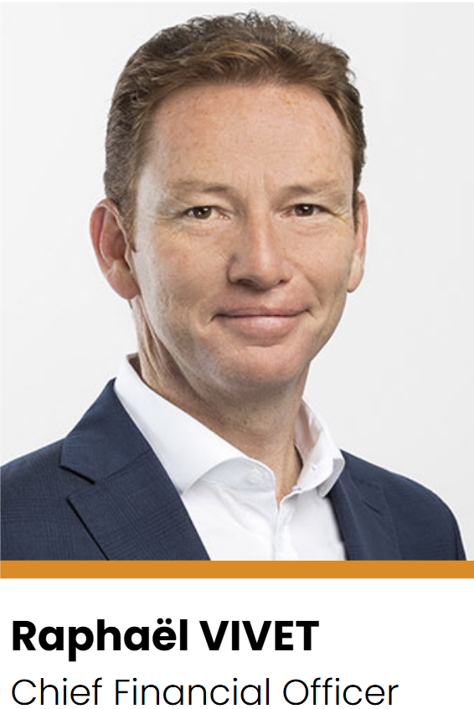



Introduction
1777 – Frédéric Japy establishes a watchmaking factory in Beaucourt, joined later by other families to make wires
1968 – Merger with other families to make GFD, creating screws and bolts for cars
1977 – The group begins manufacturing for the aerospace industry
2002 – GFD was renamed to LISI
2007 – LISI Medical is formed
LISI is a French-based manufacturer of assembly solutions and components for the aerospace, automotive, and medical sectors.
LISI’s purpose of shape and share sustainable links defines its solutions and goals.
10 executives and 25 board members

Slide 4
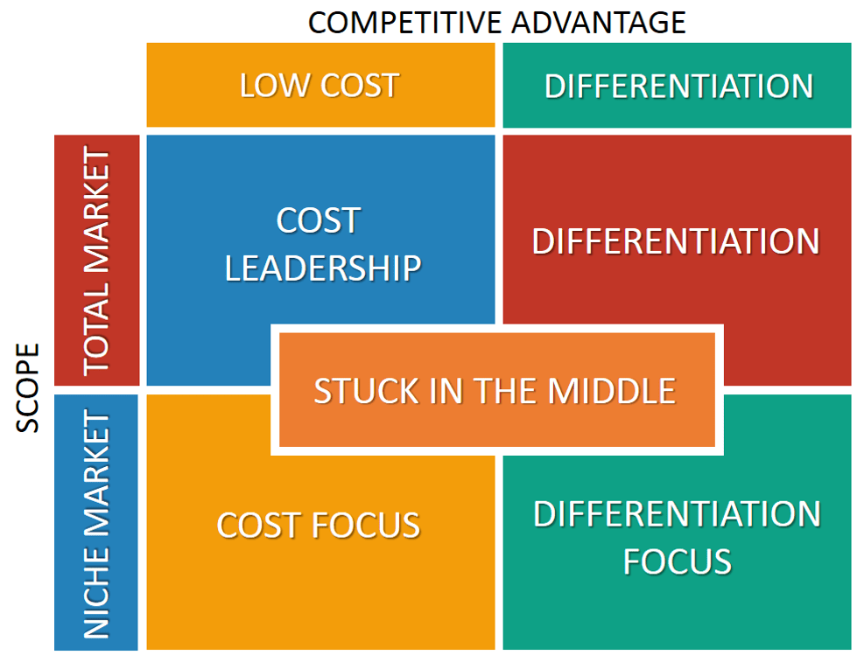







Scope
Böllhoff – German company with aerospace and automotive clients
ITW – American automotive fasteners company
ARaymond – French automotive fasteners company
Norma Group – German automotive fasteners company
Bulten – Swedish automotive fasteners company
Zimmer Biomet – American medical implant manufacturer
Smith+Nephew – English medical implant manufacturer

Slide 5
SWOT Analysis
Strengths Diverse business lines Positive reputation including large cap customers Increasing EBITDA, CapEx Aerospace fasteners segment saw high growth in 2024 in Europe and North America In 2024, increased production capacity with a 54.4M euro investment | Weaknesses High dependence of revenue on aerospace industry High operational costs of specialised products Limited revenue from outside Europe and NA
Opportunities Next generation of airplanes and vehicles require stronger, lighter, and more resilient components More sustainably made components | Threats Competition with Bolhoff, ARaymond, Norma Group, ITW, Smith+Nephew, and Zimmer Biomet Tariff barriers for exporting to USA Cheaper simple fasteners from China

Slide 6
In Detail
Opportunities
Risks
LISI’s increased net earnings and operating cash flow open opportunities to increase research and development into solutions for the next generation of aerospace and electric vehicles.
These industries are dependent on reliable, structurally strong, and lightweight components.
Despite having several manufacturing facilities in the USA, LISI would still be exposed to tariffs imposed by Trump on Canada, Mexico, China, and the EU.
Practically any imported base materials or final goods are subject to tariffs of 10-25% which can greatly impact LISI’s bottom line if customer orders drop. LISI’s current operating margin is just over 6%.

Slide 7
Income Statement
(millions of euros) | FY24
Sales Changes in inventories Other income Total Operating Revenue | 1794.05 19.796 60.778 1874.624
Consumed goods Other purchases Taxes and duties Employee benefits EBITDA | (549.169) (424.353) (10.848) (678.425) 211.829
Depreciation Provisions Non-recurring income and expenses Operating Profit | (104.25) 7.455 (23.094) 91.94
Financing expenses and cash revenue Other financial income and expenses Taxes including CVAE | (26.784) 10.883 (20.615)
Net Profit Shareholder’s Earnings | 55.424 56.006
Key Figures
Sales: 1.794B €, up 10%
EBITDA: 211.8M €, up 19%
EBIT: 115M €, up 27%
Earnings: 56M €, up 49%
Net Debt: 488.5M €, down 12.6M €
Debt to Equity Ratio: 48.6%, down 4.8 pp

Slide 8
Expectations
 | 2024 | 2029
(millions of euros) | Baseline | Pessimistic | Neutral | Optimistic
Revenue | € 1,794.05 | € 2,029.80 | € 2,289.71 | € 2,889.34
Taxes and duties | -€ 10.85 | -€ 15.57 | -€ 13.85 | -€ 12.27
EBITDA | € 211.83 | € 191.48 | € 217.18 | € 341.15
Depreciation | -€ 104.25 | -€ 167.90 | -€ 133.05 | -€ 99.14
EBIT | € 115.03 | € 130.15 | € 146.82 | € 286.24
Net earnings | € 56.01 | € 63.37 | € 71.48 | € 90.20

Slide 9
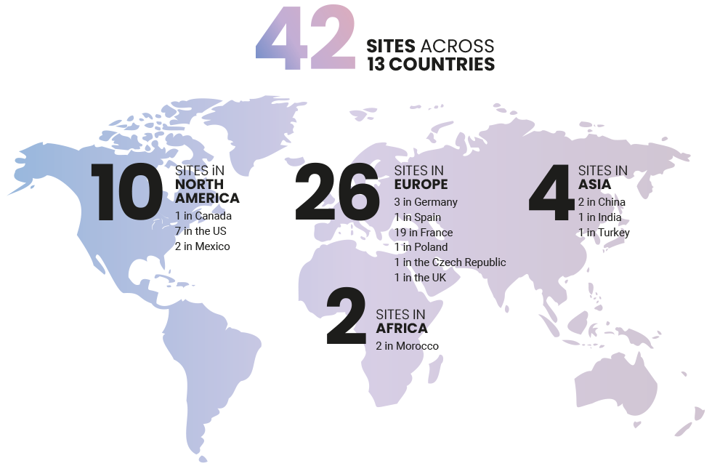
Solutions
Invest in production facilities in Latin America, Middle East and Africa, and Asia
Given the threats posed by tariff wars for the next several years and low existing revenue from outside Europe and North America, LISI should aim to increase its share in other global markets.
The estimated cost for a new plant is between 5-20M €, depending on the country and specialisation of goods produced.

Slide 10
Schedule
 | S1 2025 | S2 2025 | S1 2026 | S2 2026 | S1 2027 | S2 2027 | S1 2028 | S2 2028 | S1 2029 | S2 2029
Location scouting
Feasibility studies
Procurement of machinery
Development of supply chains
Factory construction
Commissioning
Full production

Slide 11

LISI: Shape and Share Sustainable Links
LISI’s global reputation in high-quality fasteners and assembly components support its continued growth, as seen in its double-digit revenue increases the past three years.
Net earnings are consistently strong with room to grow and reach 100M €.
Expanding production in LATAM, MENA, and ESEA will strengthen market share and provide additional revenue streams with less dependence on aerospace.

